Slide 1


Lempel-Ziv COMPRESSION ALGORITHMS for INFROMATION SOURCES
AUTHORS:
CHROUK KASEM- ECSE 456: 260 512 917
MUHAMMAD TAHA-ECSE 456: 260 505 597
PROJECT SUPEVISOR: PROFESSOR JAN BAJCSY

Slide 2
Overview
Introduction
Background
Motivation and Challenges
Project Description
Lempel-Ziv Compression Algorithm
Theory
Implementation
Implementation and Results
Implementation
Results

Slide 3

1. Introduction: Background
Early compression in the 1800’s (Morse code). [1]
Key idea: Frequent symbols LESS BITS
Example of Morse code [2]

Slide 4
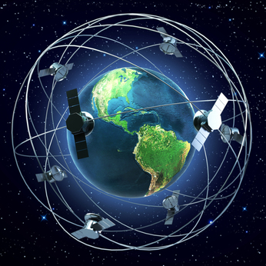
1. Introduction: Background
Compression in Communication System Architecture
Compression saves
Bandwidth
Storage space
Transmission time
BETTER SYSTEM EFFICIENCY!
Global Communication System [3]

Slide 5
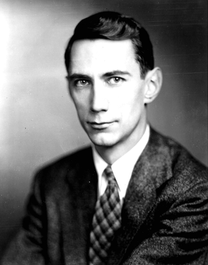
1. Introduction: Background
The modern data compression is based on Claude Shannon’s paper “A Mathematical Theory of Communication” published in 1948. [1]
Application of data compression is ENORMOUS!!
Used in both software and hardware devices.
Huffman | Lempel-Ziv
JPEG | GIF
FAX MACHINES | ZIP
MP3 | UNIX File system
Applications of compression codes [5]
Claude Elwood Shannon (1916–2001) [4]

Slide 6

1. Introduction: Motivation & Challenges
Motivation:
Implementations of compression algorithms on information source with/without memory
Compression efficiency should be 3:1 or 2:1.
Error free decompression
Challenges
Efficient implementation
Challenges of compression codes [5]
UNIVERSAL:
The code responds to different inputs.

Slide 7
1. Introduction: Project Description
Main Objective: Implement, evaluate and stress-test selected Data compression techniques.
Identified the following algorithms for designing:
Huffman compression Encoder
Huffman compression Decoder
Adaptive Huffman Codebook
Adaptive Huffman Decoder
Adaptive Huffman Encoder

Slide 8
2. Huffman Compression Algorithm

Slide 9


2. Huffman Compression Algorithm
Macmillan Inequality
Shannon Compression Theorem
Equation$:\sum_{i=0}^{n}{2^{−l_{i}}≤1}$
Must be satisfied by any Uniquely Decodable code
Huffman Algorithm always satisfies it. [5]
Equation$:$
$H\left(x\right)≤E\left(l\right)<H\left(x\right)+1$
Set the limits for the maximum compression of any code [5]

Slide 10
2. Fixed Huffman Code Example
X | P(x)
A | 0.5
B | 0.3
C | 0.2
A
0.5
0
B
0.3
0
1.0
1
1
0.5
C
0.2
Traverse on the Huffman tree to form the codebook
Merge least two probabilities
Assign ‘0’ to higher probability and ‘1’ to lower probability
Repeat
Mcmillian: 1
E(l) = 1.5
H(x) = 1.49
H(x) + 1 = 2.49
A -> 0
B -> 10
C -> 11

Slide 11
2. Universal Huffman Algorithm Implementation

Slide 12
Module 1: Combine Probabilities function
P = [0.6, 0.4]
P = [0.4, 0.3, 0.3]
CB_split = []
CB_split = [1]
i = 1
0.6 > 0.4 ?
q = [0.6, 0.4]

Slide 13
Module 2: Generate Codebook function
CB_split = [1]
split = 1
CB = [00, 00, 10]
CB = [0, 1]
CB = [10, 00, 01]
CB = [00, 01, 10]
CB = [00, 10]
L = [1, 1]
L = [2, 1]
L = [1, 2, 2]
L = [2, 2, 1]

Slide 14
Module 3: Universal Encoder
Source = ‘bca’
‘a’
1
‘b’
00
‘c’
01
Source_Index = 3;
Length source = 3;
Source_Index = 4;
Length source = 3;
Source_Index = 2;
Length source = 3;
Source_Index = 1;
Length source = 3;
Comp_String = 00
Comp_String = 0001
Comp_String = 00011
Compr_String = 00011

Slide 15
Module 4: Universal Decoder
Codebook:
‘a’
1
n = 1
‘b’
00
n = 2
‘c’
01
Comp_String = 00011
dataHAT = b
dataHAT = bca

Slide 16
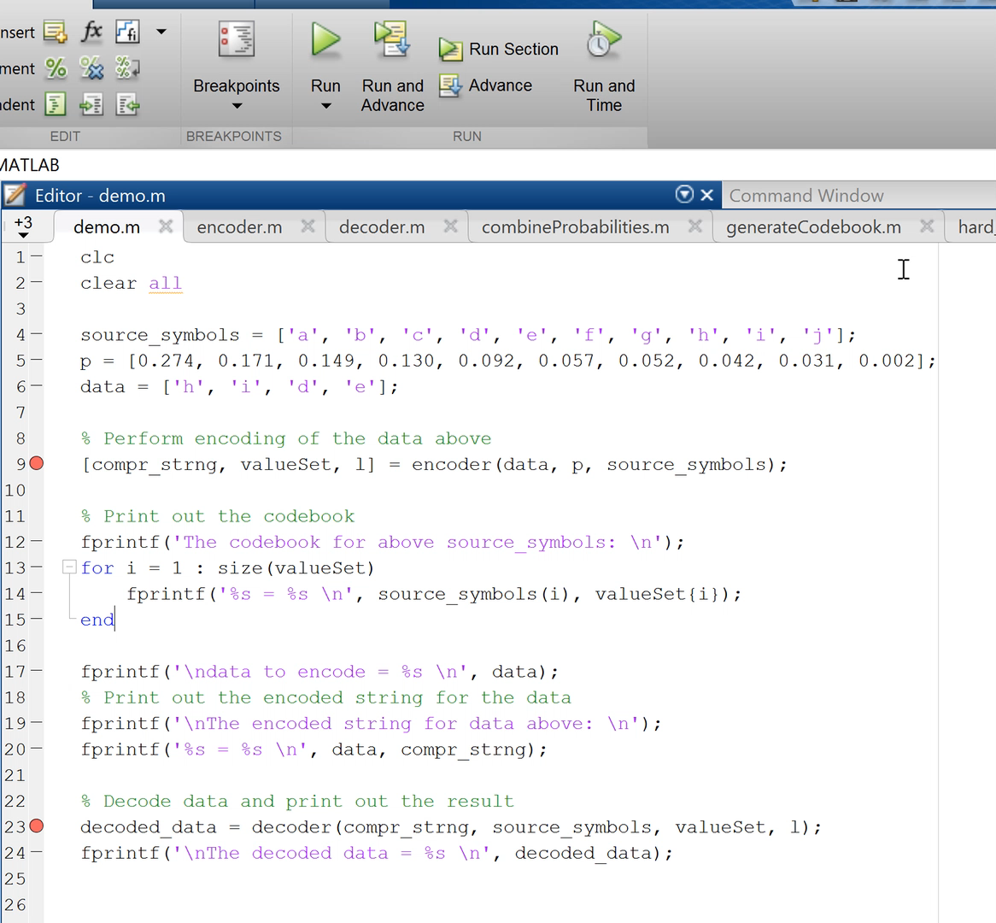

Slide 17
2. Huffman Algorithm: Implementation Constraints
Initial encoder/ decoder structure
Efficiency test
Universal Codebook generator
Universal encoder/ decoder
Used hard- coded codebook of fixed source
Tests with varying data lengths and randomly generated data
Tests with varying data of fixed size
Tested encoder’s efficiency
Tried binary tree data structure ×
Used built in sorting functions ×
Codebook has varying lengths. Cannot be stored as matrix ×
Implemented manual sorting ✓
Developed L vector to track code-word length ✓
Used universal codebook generator in encoder/ decoder
Implemented test bed to test overall algorithm
A
0.5
0
B
0.3
0
1.0
1
1
0.5
C
0.2
KEY CHALLENGE: LEAVES TO ROOT in Huffman tree construction use RECURSIVE implementation

Slide 18
2. Huffman Algorithm: Efficiency
Example:
‘0’ -> 1 – p = 0.5
‘1’ -> 00 - p = 0.3
‘2’ -> 01 - p = 0.2
Efficiency?
E(l) = ∑ p_{i} × l_{i}
in bits/symbol
Efficiency = 0.5 × 1 + 0.3 × 2 + 0.2 × 2 = 1.5 bits/symbol
Test: Observe what happens when compression is performed 1000 times for random data of fixed lengths.
Length of data is 5, 25 and 100 symbols for figures (a), (b) and (c) respectively in the next slide.

Slide 19
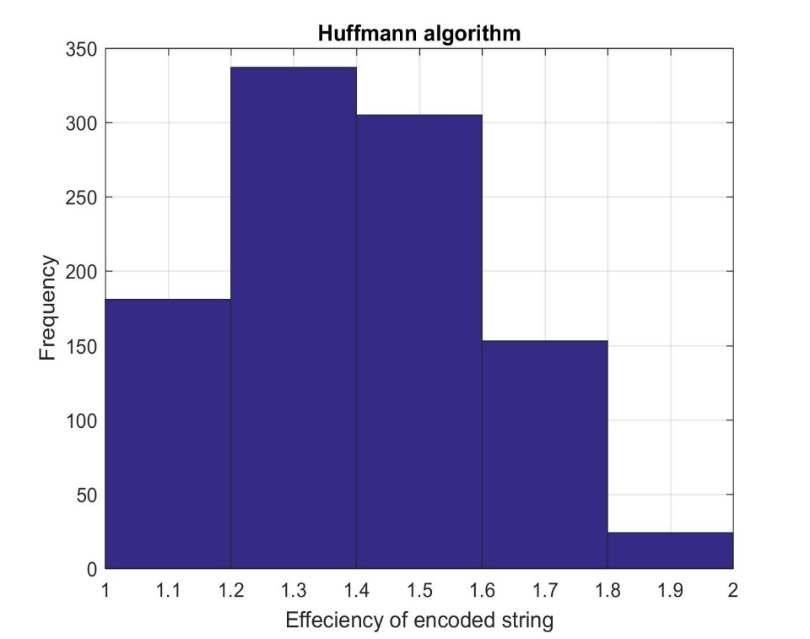
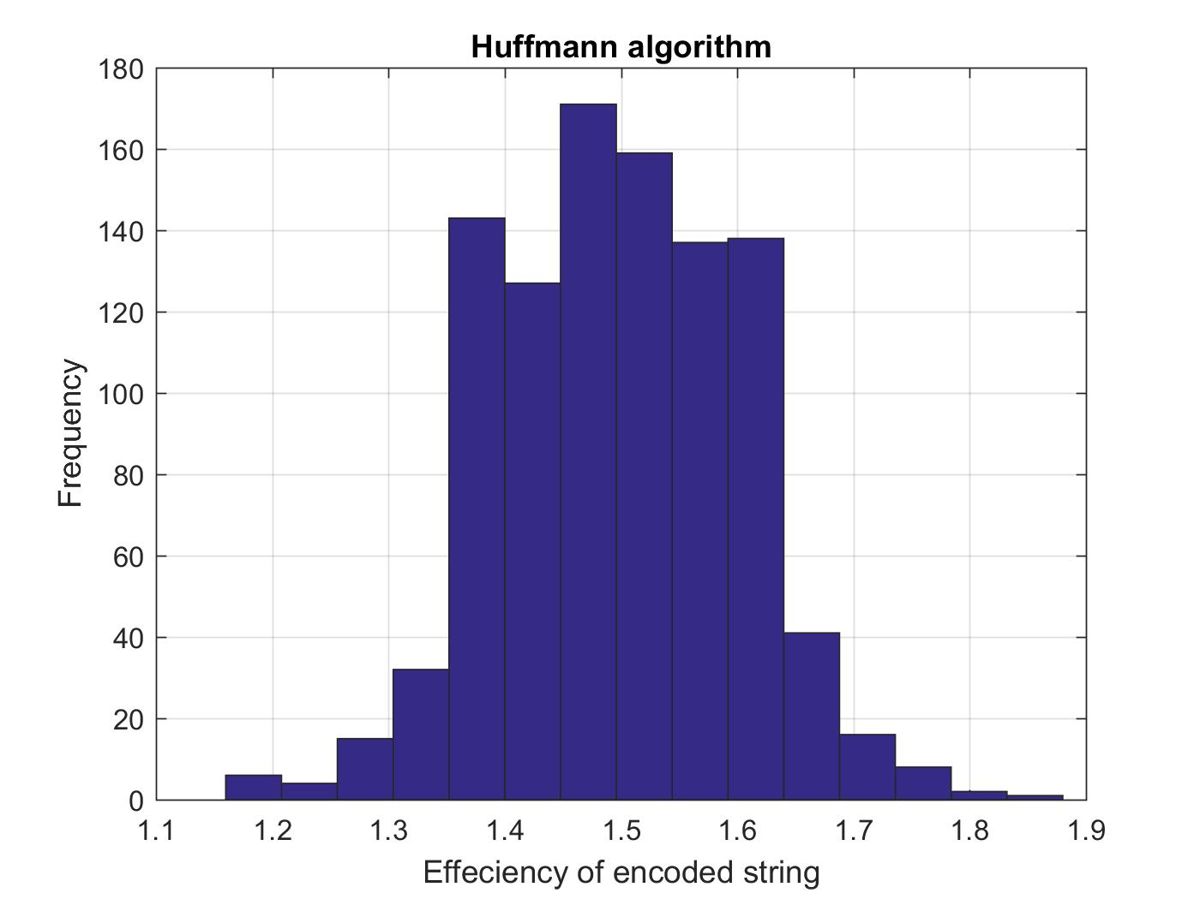
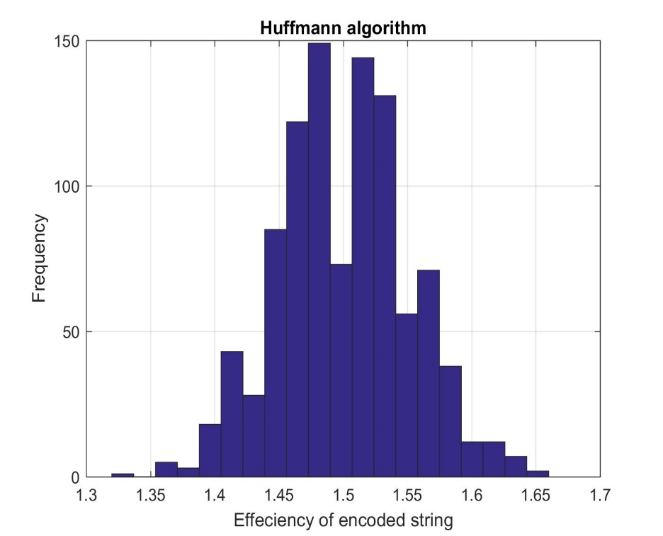
2. Huffman Algorithm: Observations of efficiency test
Fig a: Data size = 5
Fig b: Data size = 25
Fig c: Data size = 100
Efficiency of compressed data follows a normal distribution
Most of the data compressed is close to the efficiency of 1.5 bits/source symbol
The distribution is narrower for larger data size

Slide 20
3. Conclusion
Learnt and implemented UNIVERSAL Huffman compression
Learnt design and implementation of signal processing functions in MATLAB
Used important performance evaluation techniques, such as the histograms for efficiency
Started research on other important algorithms required for the next part of the project; Lempel-Ziv and the turbo compression.
Some possible applications:
Hard Coded Huffman: Could be used in the Twitter data base to compress tweets which have the same content
Adaptive Huffman: Image in JPEG format, compression of hyperspectral data from satellites

Slide 21
4. Work Breakdown and Future Work
Semester’s Timeline
April

Slide 22
4. Work Breakdown and Future Work
Plan For Next Semester
New
Functions
Lempel-Ziv
Run-length Coding
Merge the new code with the old
Create a source generation file
Use histograms for efficiency testing
Testing On
Data Sources
Merge the functions and implement on actual data sources. For example: images, folders
Turbo Compression

Slide 23
4. Work Breakdown and Future Work
Plan For Next Semester

Slide 24
5. References
[1] S. W. 2002, "Historical notes: History [of data compression]," 2002. [Online]. Available: https://www.wolframscience.com/reference/notes/1069b.
[2] R. T. Snodgrass, Radio Receiving for Beginners, V. F. Camp, Ed. New York: The MacMillan Company, 1992.
[3] A-Read, "Satellite communication systems," in A Read. [Online]. Available: http://www.a-read.com/satellite-communication-systems/.
[4] Bell Labs, "Claude Elwood Shannon 1916-2001," in wikipedia.com, 2011. [Online]. Available: http://it-science.net/images/shannon.small.jpg.
[5] J. G. Proakis, Communication Systems Engineering, M. Salehi, Ed., 2nd ed. Pearson, 2001.
Thank You!

Slide 25
Backup Slides

Slide 26
Software Used
Used MATLAB to code these functions.
Reason for choosing MATLAB:
It’s extensive Math Library.
Easy to deal with vectors and matrices
Implementation on other programming languages, for example C or JAVA, will be very simple after coding on MATLAB.

Slide 27
Source Encoder/Decoder

Slide 28
Channel Encoder/Decoder

Slide 29
Universal Communication Systems Architecture

Slide 30
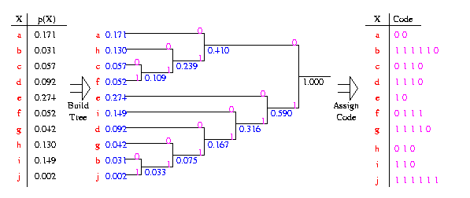
Huffman Encoding: Practical Example

Slide 31
Semester’s Timeline

